Slide 1
MVC 패턴과 Spring

Slide 2
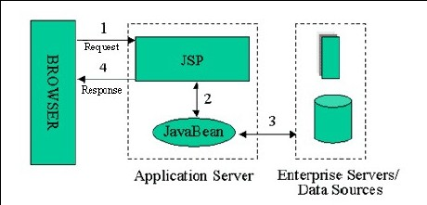
MVC
모델 1

Slide 3
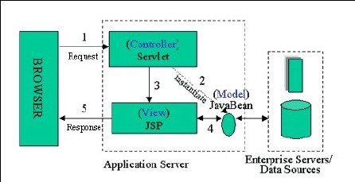
MVC
모델 2 - MVC

Slide 4
MVC
Controller(또는 Action)
사용자 입력 데이터 추출
입력 데이터에 대한 유효성 체크(Java Script를 이용할 경우 JSP(View)에서도 가능)
입력 데이터를 비즈니스 Layer로 전달하기 위한 변환 작업
비즈니스 Layer와 Interface
비즈니스 Layer에서 발생한 에러 처리
비즈니스 Layer에서 반환된 데이터를 View에 전달

Slide 5
MVC
Model ?

Slide 6
MVC
Model
Domain Model
=

Slide 7
MVC
Domain Model
+
Model
Business Obj
=
+
DAO

Slide 8
MVC
모델 1
B
R
O
W
S
E
R
1. Request
JSP
2. Response

Slide 9
MVC
모델 2
1. Request
B
R
O
W
S
E
R
(Controller)
Servlet
2. Response
3. Request
(View)
JSP
4. Response

Slide 10
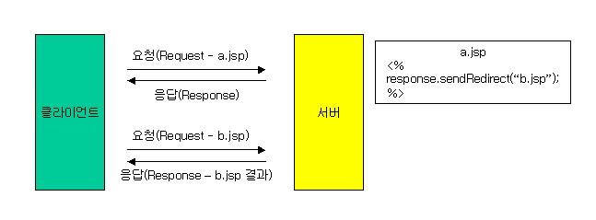
Spring Framework - MVC

Slide 11
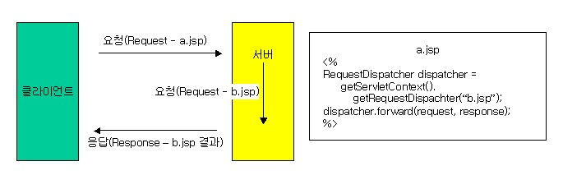
Spring Framework - MVC

Slide 12
Spring Framework - MVC
모델2 기반 프레임워크 만들기

Slide 13
Spring MVC
HandlerMapping
2
요청
DispatcherServlet
3
Controller
1
ModelAndView
4
5
ViewResolver
6
View

Slide 14
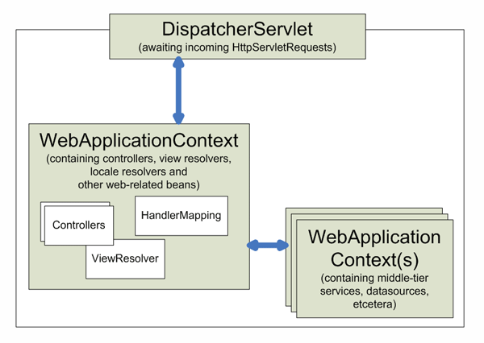
Spring MVC

Slide 15
Spring MVC - Controller
실습 1
HelloWorldController

Slide 16
Spring MVC
BeanNameUrlHandlerMapping
2
/index.html
DispatcherServlet
3
MyUrlFilenameViewController
1
ModelAndView
“index”
4
5
InternalResourceViewResolver
6
/WEB-INF/jsp/index.jsp

Slide 17
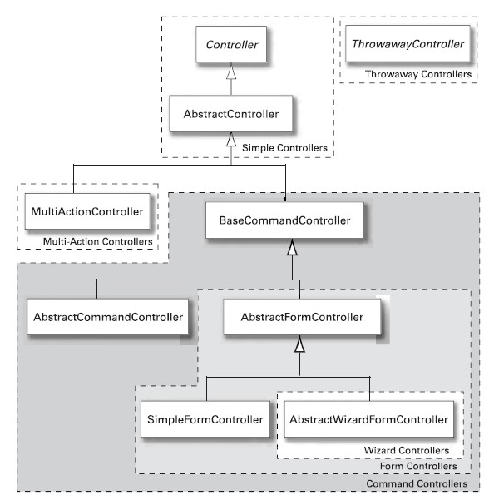
Spring MVC - Controller

Slide 18
Spring MVC - Controller
UrlFilenameViewController
=
No Model 데이터
정적인 페이지

Slide 19
Spring MVC - Controller
MultiActionController
=
DispatchAction of Struts
Action of Webwork

Slide 20
Spring MVC - Controller
B
R
O
W
S
E
R
List.do
ListAction
Insert.do
InsertAction
Update.do
UpdateAction
View.do
ViewAction
Delete.do
DeleteAction
=
1 : 1
URL : Action

Slide 21
Spring MVC - Controller
단점
URL이 추가될 때마다 Action(Controller)를 추가해야함.
Action(Controller)가 추가될 때마다 설정 파일에 Action 정보 추가
하나의 URL이 추가될 때마다 추가되어야 하는 부분이 많아짐으로서 생산성 저하.
Action(Controller)의 숫자가 많아질수록 유지보수의 어려움.
너무도 복잡한 설정 파일로 인해 유지보수의 어려움.

Slide 22
Spring MVC - Controller
SampleAction
B
R
O
W
S
E
R
List.do
Insert.do
Update.do
View.do
Delete.do
=
N : 1
URL : Action

Slide 23
Spring MVC - Controller
실습 2
MultiHelloWorldController

Slide 24
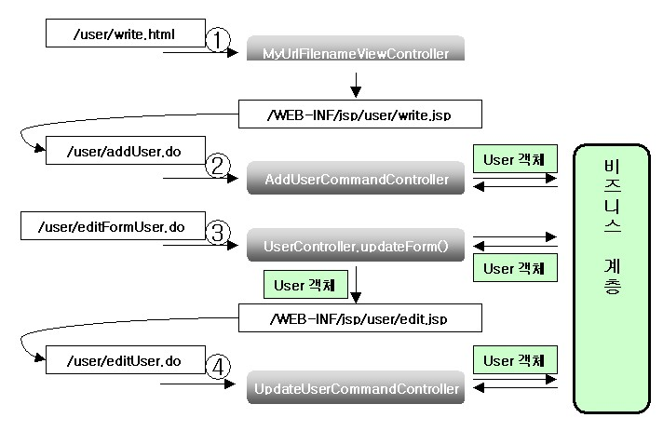
Spring MVC - Controller
기존 방식

Slide 25
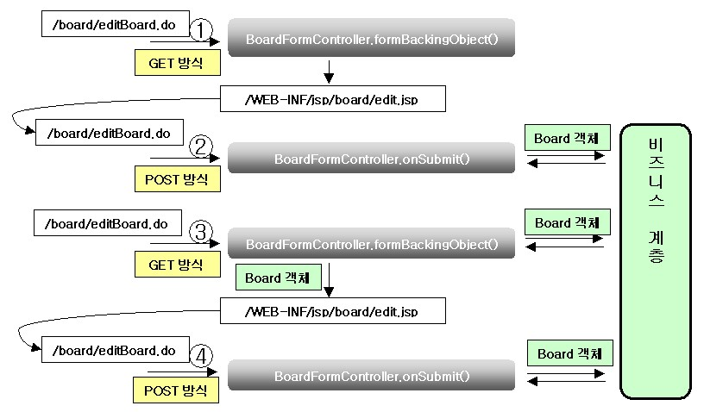
Spring MVC - Controller
SimpleFormController

Slide 26
Spring MVC - BeanNameHandlerMapping
<bean id="handlerMapping" class="org.springframework.web.servlet.handler.BeanNameUrlHandlerMapping"/>
<bean name="/user/login.do" class="net.javajigi.user.web.LoginFormController">
<property name="validator" ref="beanValidator" />
<property name="formView" value="/decorators/login" />
<property name="successView" value="redirect:/index.html" />
<property name="userService" ref="userService" />
</bean>
<bean name="/board/board.do" class="net.javajigi.board.web.BoardController">
<property name="boardService" ref="boardService" />
<property name="methodNameResolver" ref="methodNameResolver" />
</bean>

Slide 27
Spring MVC - SimpleUrlHandlerMapping
<bean id="loginFormController" class="net.javajigi.user.web.LoginFormController">
<property name="validator" ref="beanValidator" />
<property name="formView" value="/decorators/login" />
<property name="successView" value="redirect:/index.html" />
<property name="userService" ref="userService" />
</bean>
<bean id="boardController" class="net.javajigi.board.web.BoardController">
<property name="boardService" ref="boardService" />
<property name="methodNameResolver" ref="methodNameResolver" />
</bean>

Slide 28
Spring MVC - SimpleUrlHandlerMapping
<bean id="urlMapping" class="org.springframework.web.servlet.handler.SimpleUrlHandlerMapping">
<property name="mappings">
<props>
<prop key="/user/login.do">loginFormController</prop>
<prop key="/board/board.do">boardController</prop>
</props>
</property>
</bean>

Slide 29
Spring MVC - Interceptor
Spring MVC의 Interceptor
<bean id="urlMapping" class="org.springframework.web.servlet.handler.SimpleUrlHandlerMapping">
<property name="interceptors">
<list>
<ref bean="profilingInterceptor"/>
</list>
</property>
<bean id="loggingInterceptor" class="net.javajigi.web.LoggingInterceptor"/>
<property name="mappings">
<props>
<prop key="/user/login.do">loginFormController</prop>
<prop key="/board/board.do">boardController</prop>
</props>
</property>
</bean>

Slide 30
Spring MVC - View
JSTLView
HTML 문서
ExcelView
Excel 문서
Model
PDFView
PDF 문서
CSVView
CSV 문서

Slide 31
Spring MVC - ViewResolver
InternalResource ViewResolver
JSP
Velocity ViewResolver
Velocity
Model
FreeMarker ViewResolver
Freemarker
ResourceBundleViewResolver
ResourceBundle

Slide 32
Spring MVC - ViewResolver
ViewResolver Chain
<bean id="xmlViewResolver" class="org.springframework.web.servlet.view.XmlViewResolver">
<property name="order" value="1"/>
<property name="location" value="/WEB-INF/ajasee-views.xml"/>
</bean>
<bean id="viewResolver" class="org.springframework.web.servlet.view.InternalResourceViewResolver">
<property name="viewClass">
<value>org.springframework.web.servlet.view.JstlView</value>
</property>
<property name="cache" value="false" />
<property name="prefix" value="/WEB-INF/jsp/" />
<property name="suffix" value=".jsp" />
</bean>
InternalResourceViewResolver는 항상 Chain의 마지막

Slide 33
Property Editor
Property Editor ?
java.beans.PropertyEditor

Slide 34
Property Editor
<beans>
<bean id="builtInSample" class="PropertyEditorBean">
<property name="class">
<value>java.lang.String</value>
</property>
<property name="file">
<value>c:/test.txt</value>
</property>
<property name="locale">
<value> en-GB </value>
</property>
<property name="url">
<value>http://www.springframework.org</value>
</property>
<property name="properties">
<value>
name=foo
age=19
</value>
</property>
<property name="strings">
<value>rob,jan,rod,jurgen,alef</value>
</property>
<property name="bytes">
<value>Hello World</value>
</property>
</bean>
</beans>

Slide 35
Property Editor
import java.io.File;
import java.net.URL;
import java.util.Locale;
import java.util.Properties;
public class PropertyEditorBean {
private Class cls;
private File file;
private URL url;
private Locale locale;
private Properties properties;
private String[] strings;
private byte[] bytes;
}

Slide 36
Spring 2.0
Convention over Configuration
(CoC)

Slide 37
Spring 2.0
Controller
<bean class="org.springframework.web.servlet.mvc.support.ControllerClassNameHandlerMapping" />
HelloWorldController => helloworld.do
HelloWorldController.hello => helloworld/hello.do

Slide 38
Spring 2.0
Model
x.y.User => user
java.util.HashMap => hashMap
x.y.User[] => userList
하나 이상의 x.y.User 인스턴스를 가지는 java.util.ArrayList => userList

Slide 39
Spring 2.0
View
<bean id="viewNameTranslator"
class="org.springframework.web.servlet.view.DefaultRequestToViewNameTranslator" />
<bean id="viewResolver"
class="org.springframework.web.servlet.view.InternalResourceViewResolver">
<property name="prefix" value="/WEB-INF/jsp/" />
<property name="suffix" value=".jsp" />
</bean>
http://localhost:8080/helloworld.do => WEB-INF/jsp/helloworld.jsp
http://localhost:8080/helloworld/hello.do => WEB-INF/jsp/helloworld/hello.jsp

Slide 40
Spring 2.0
실습 3
MultiHelloWorldController를
CoC 기반으로 변경

Slide 41
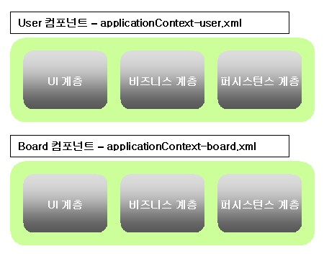
Spring 설정 파일 관리
수평적 분리

Slide 42
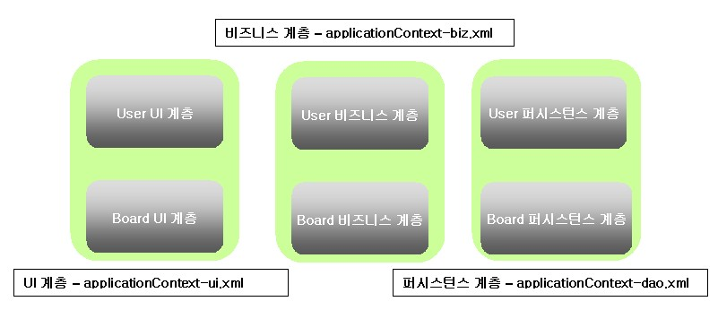
Spring 설정 파일 관리
수직적 분리

Slide 43
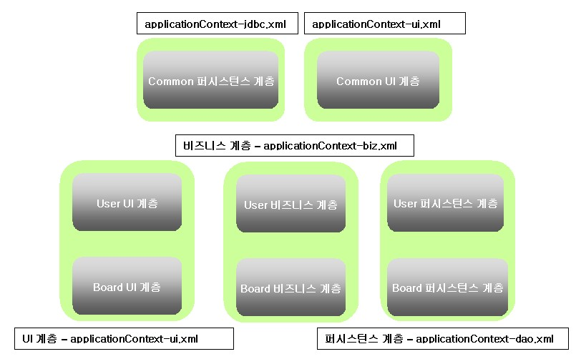
Spring 설정 파일 관리
중소규모

Slide 44
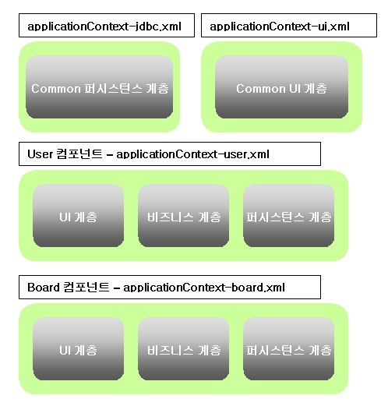
Spring 설정 파일 관리
중대규모

Slide 45
참고문서!!
RequestDispatcher를 이용할 경우 문제점과 해결방법 :
http://wiki.javajigi.net/pages/viewpage.action?pageId=77
Simplify Your Web App Development Using the Spring MVC Framework : http://www.devx.com/Java/Article/22134/1954?pf=true
Property Editor Sample : http://www.java2s.com/Code/Java/Spring/PropertyEditorBean.htm

